Slide 1
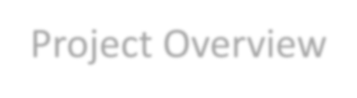
Project Overview
Security Alert

Slide 2
Project Goals
Flow diagram
Login interface
Operating page
Real-time location tracking
Alert reporting
Cross OS deployment

Slide 3
Flow Diagram
Security Guard – User Flow
Login
Cell phone number
Password
Home
Alert
Log
Emergency Icon
Status
Settings
User
Hotspots
Security needed
Medical services
GPS coords
Confirm alert
Tracking

Slide 4
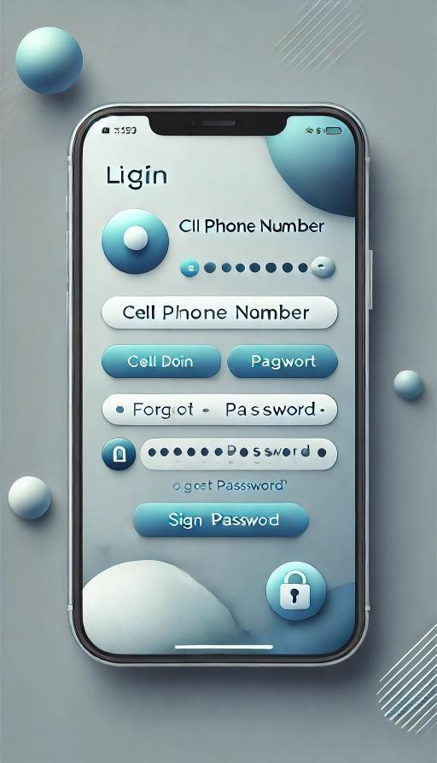
Login interface
Designer concept
Cell phone number
Password
Password reset

Slide 5
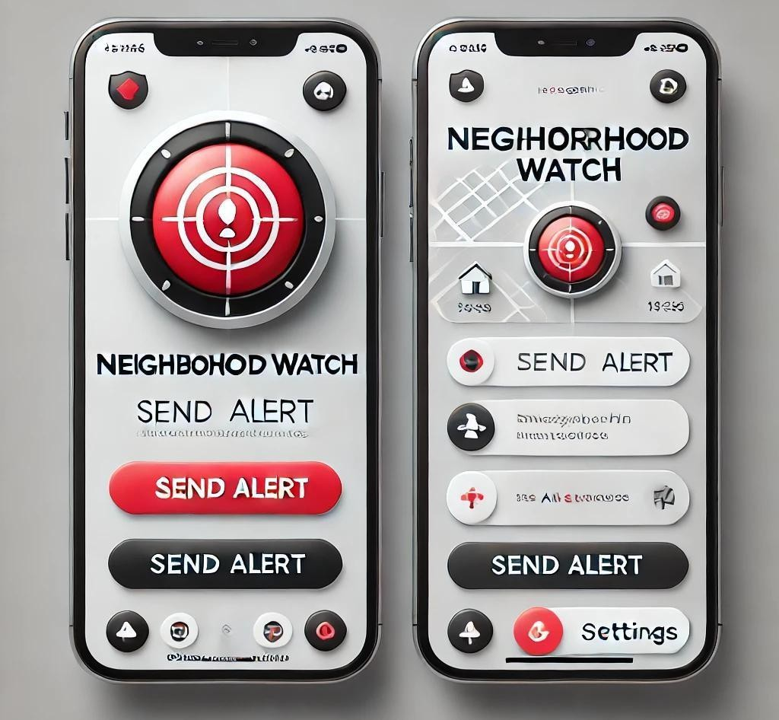
Operating page
Designer concept
Red alert for Security
Blue alert for Medical services

Slide 6
Real-time location tracking
Map allocation.
GPS coordinates
Map plot – nearest address?
Tracking

Slide 7
Alert reporting
Security Login
Full tracking
Response confirmation
Whatsapp group alert

Slide 8
Cross OS deployment
Python-based app.
Apple
Android
Windows
-for more info…List location or contact for specification (or other related documents)

